Slide 1
Comparison of spatio-temporal burned area distribution
Sriram Krishnasamy Seenivasan Tutor: Prof. Giovanna Venuti
Rishikesh Miriyala Dr. Daniela Stroppiana
Ghulam Abbas Zafari

Slide 2
Why Study Burned Area Distribution in Australia?
Australia faces frequent, intense bushfires, especially during summer.
The 2019–2020 ‘Black Summer’ highlighted severe ecological and economic impacts.
Understanding fire dynamics is crucial for risk mitigation and land management.
Google Earth Engine (GEE) offers scalable tools for spatio-temporal analysis.

Slide 3
Project Objectives
Compare MODIS MCD64 and FIRMS fire datasets.
Analyse spatial and temporal trends in burned areas.
Study environmental impacts: NDVI, LULC, LST, and forest loss.
Utilize Google Earth Engine for scalable cloud-based processing.

Slide 4
Datasets and Tools
MCD64A1 (MODIS) – Burned Area
FIRMS – Active Fire Points
MOD11A1 – Land Surface Temperature (LST)
MOD13A2 – NDVI (Vegetation Health)
MCD12C1 – Land Use Land Cover (LULC)
Hansen – Global Forest Change
Tools: Google Earth Engine, QGIS, Python

Slide 5
Workflow in Google Earth Engine
Define Region of Interest (Australia) using GAUL boundaries.
Filter and preprocess MODIS, FIRMS, Hansen datasets.
Calculate burned area, NDVI, LST, LULC, and forest loss.
Visualize and export results: maps, time series, statistics.

Slide 6
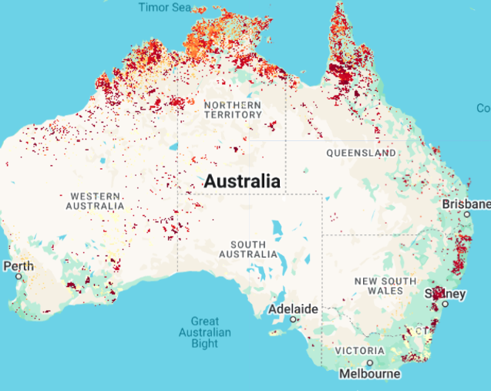
Burned Area Analysis (2019–2021)
Burned area calculated using MODIS MCD64A1 at scale of 500m.
Active fire points categorized by temperature (FIRMS ) at scale of 500m.
Annual burned area maps generated.
Exported statistics to CSV and files in GeoTIFF.

Slide 7
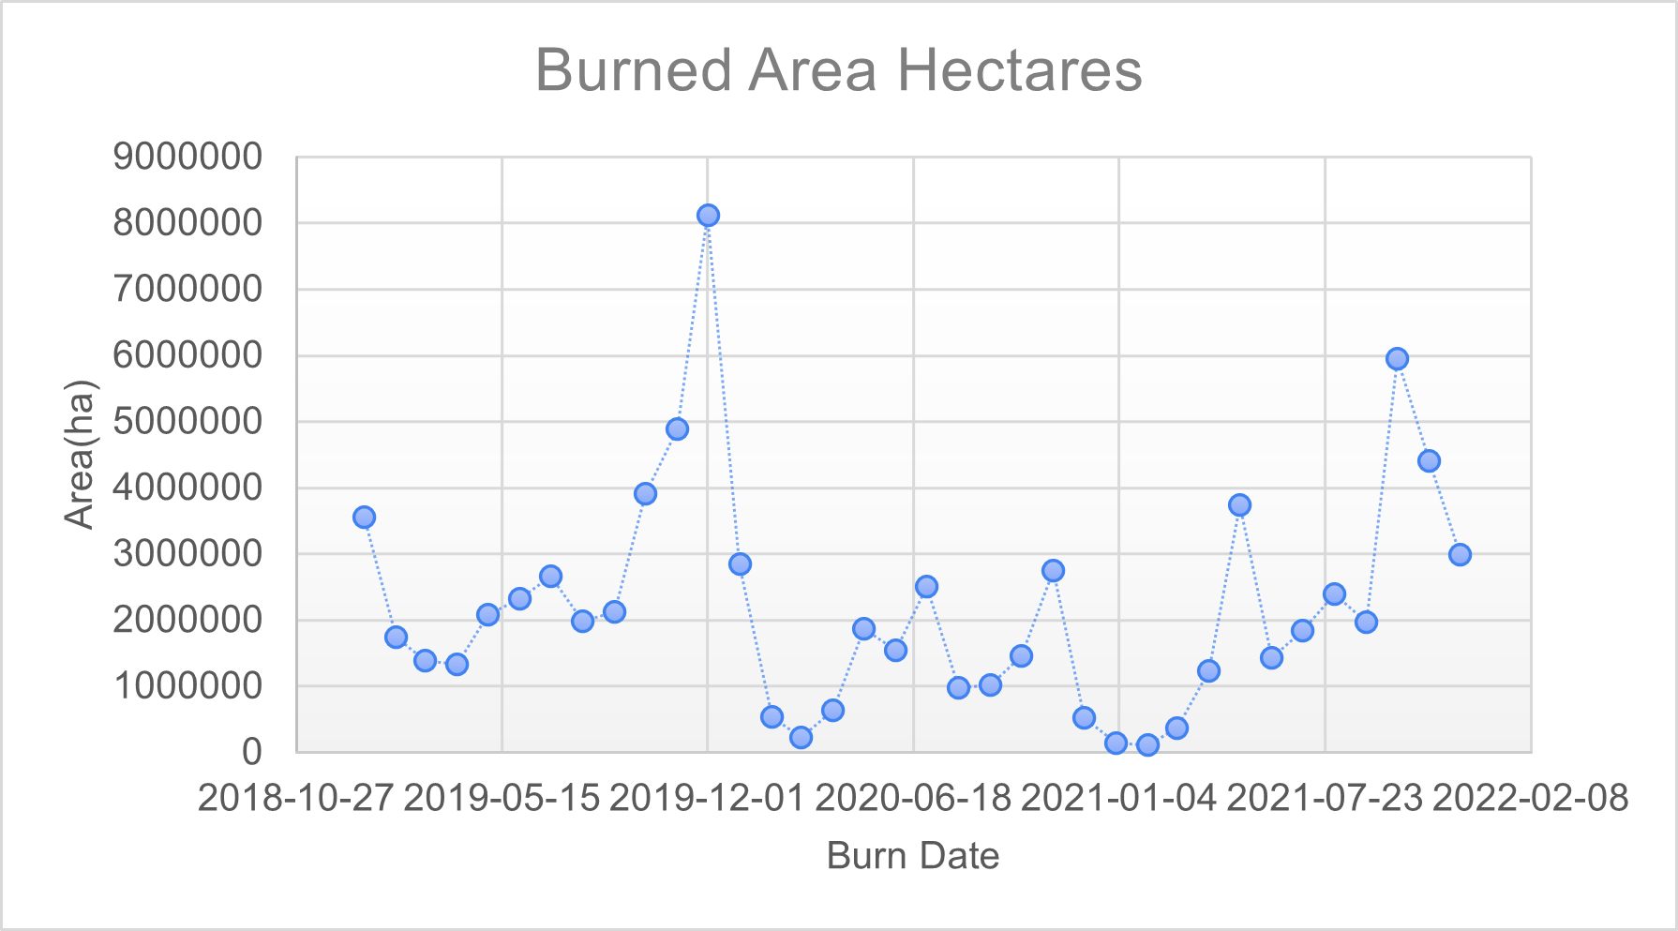
Burned Area(2019-2022)

Slide 8
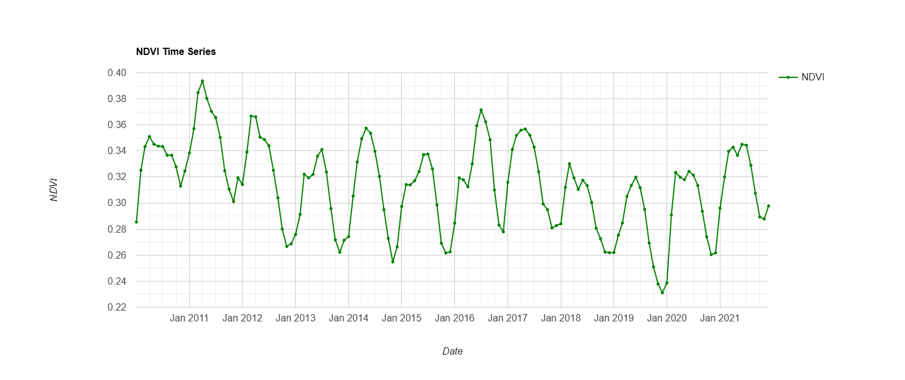
Vegetation Health & Temperature
NDVI monthly time series from 2010 to 2021 at a scale of 1000m.
Mean LST visualized using MOD11A1 for 2019.

Slide 9
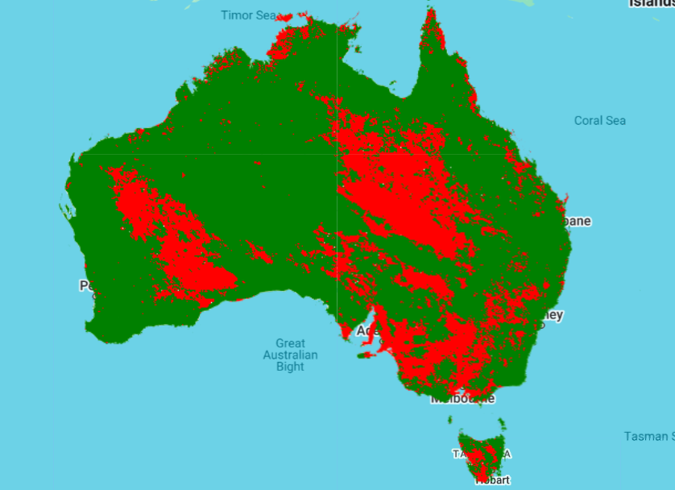
NDVI Anomaly
NDVI anomaly analysis (2020 vs 2021) detects post-fire recovery.
Vegetation degradation and regrowth visualized spatially.
Indicate a decline in vegetation health cover in 2021 compared to 2020.
Indicate vegetation regrowth or improvement, possibly due to recovery post-fire.

Slide 10
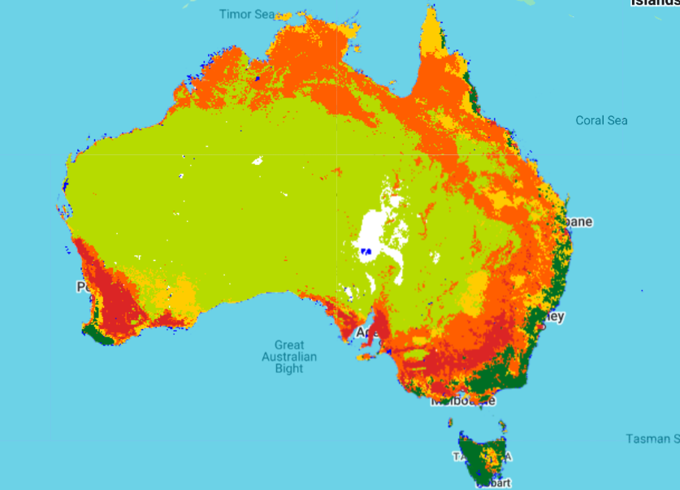
Land Cover and Forest Change
Reclassified LULC from MODIS MCD12C1 (2022).
Area statistics calculated per land cover class (e.g., forest, grass, cropland).
Type | Area km² | Type | Area km²
Forest | 260450 | Shrubs | 4474151
Grasslands | 527369 | Cropland | 1890771
Mixed | 348860 | Sparse | 314
Water | 42950 | Snow/Ice | 143696

Slide 11
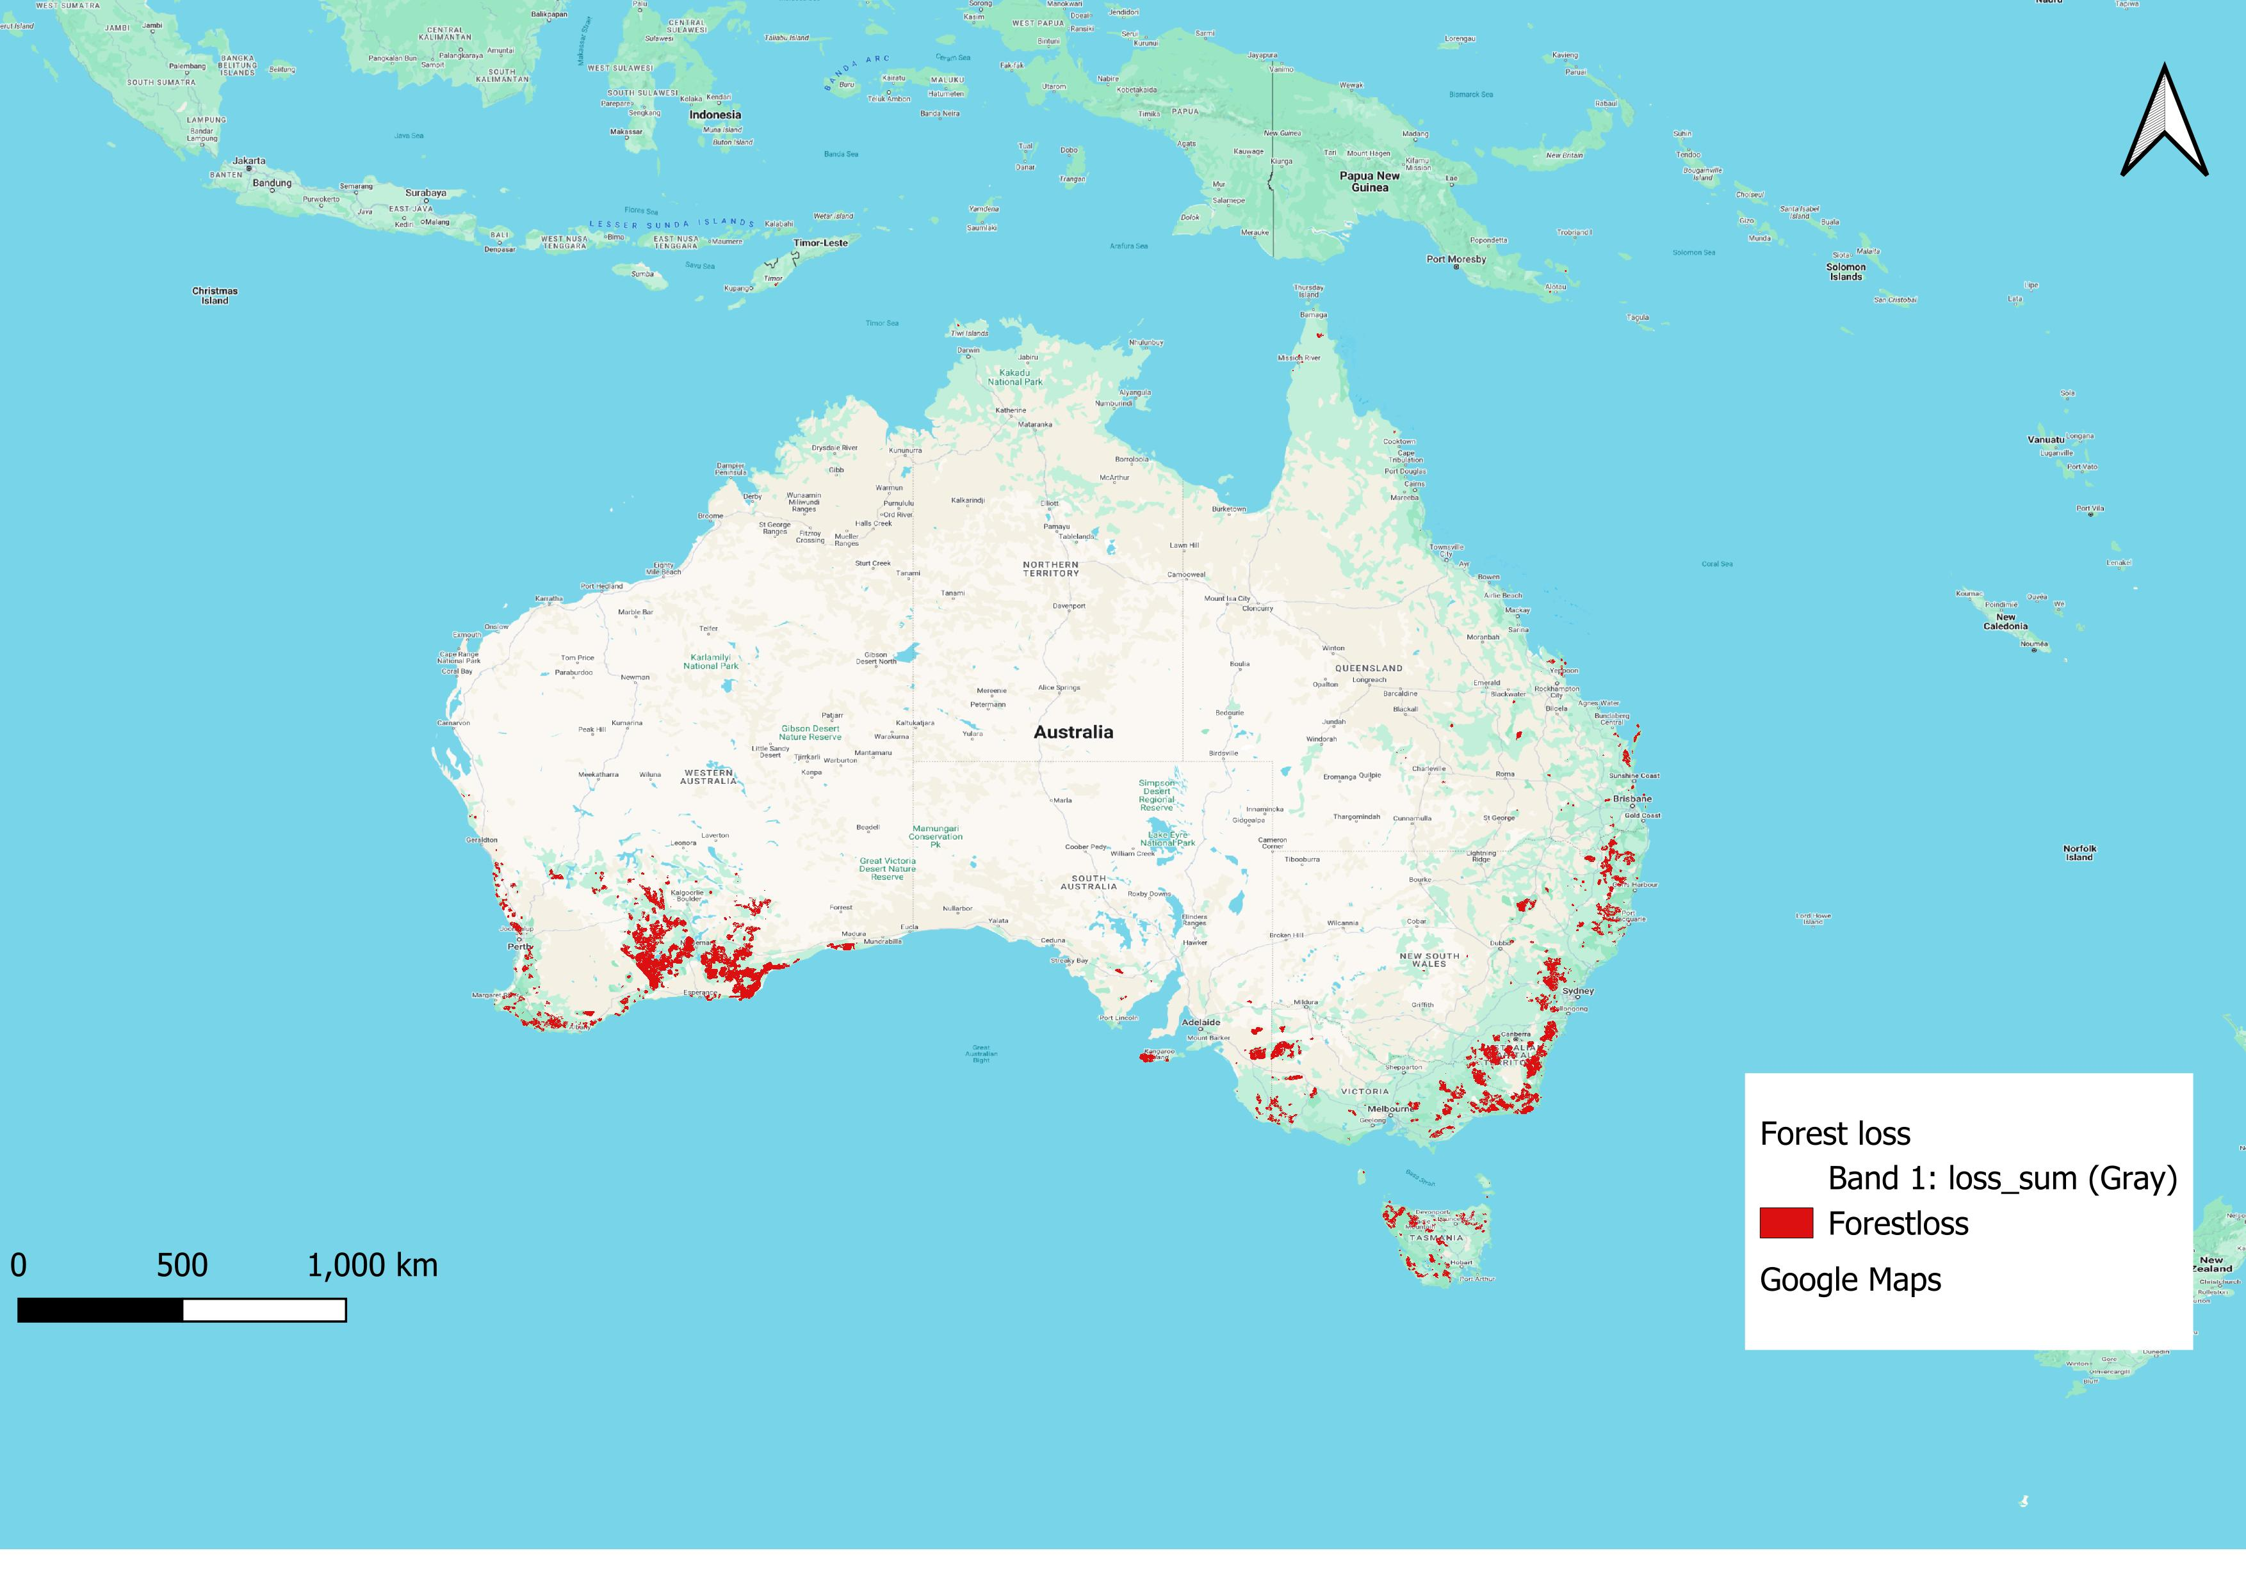
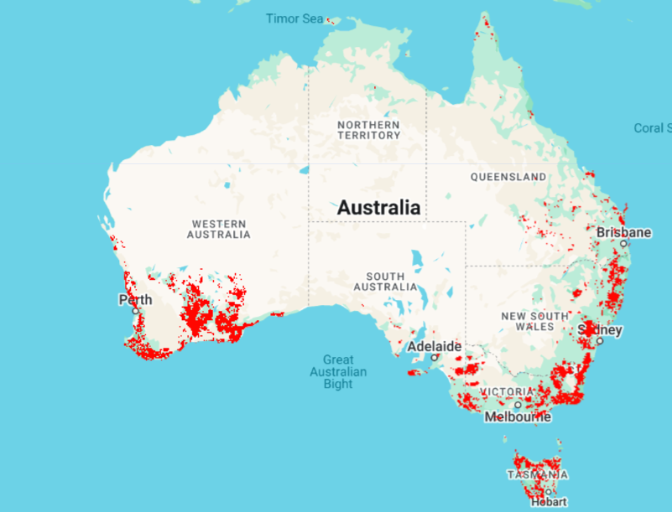
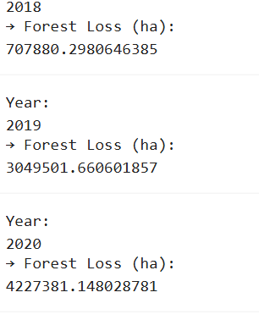
Forest Loss
Annual forest loss (2002–2022) using Hansen dataset.
Hotspot map shows spatial distribution of forest loss.

Slide 12
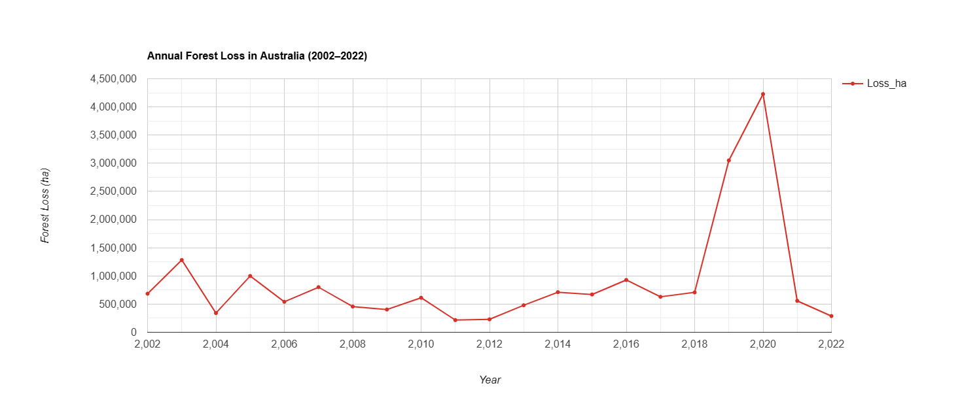
Insights and Interpretation
Fires impacted forest, grasslands and shrub regions the most.
NDVI anomalies showed clear vegetation loss after 2020.
Forest loss peaked in 2019–2020; hotspots aligned with fire zones.
.

Slide 13
Conclusion & Challenges
From the analysis, we confirm that around 8,000,000 ha forest was lost during 2019-2021.
During the Black Summer fire season (late 2019 to early 2020), there’s a noticeable spike in burned area, indicating intense fire activity over that period.
Google Earth Engine efficiently visualized burned are maps with high resolution enabling rapid analysis. However, due to vast data volume and export limitations extracting results were challenging and constrained large scale processing.

Slide 14
THANK YOU

